Slide 2
Bug Address
Issue: donors were including treated units.
Only affected the estimation of AAA outcome. The algorithm was selecting AA as a donor and assigning 12% of weight.
Went undetected because donor weight plot does not shows weight without label.

Slide 3
Bug Address
After correction
AAA: Effect increases in magnitude, but loses precision (still statistically significant)

Slide 4
Bug Address

Slide 5
Bug Address

Slide 6
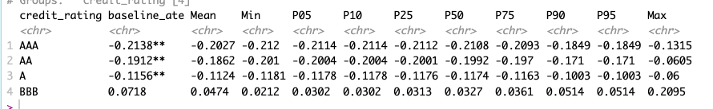
Leave One Out

Slide 7
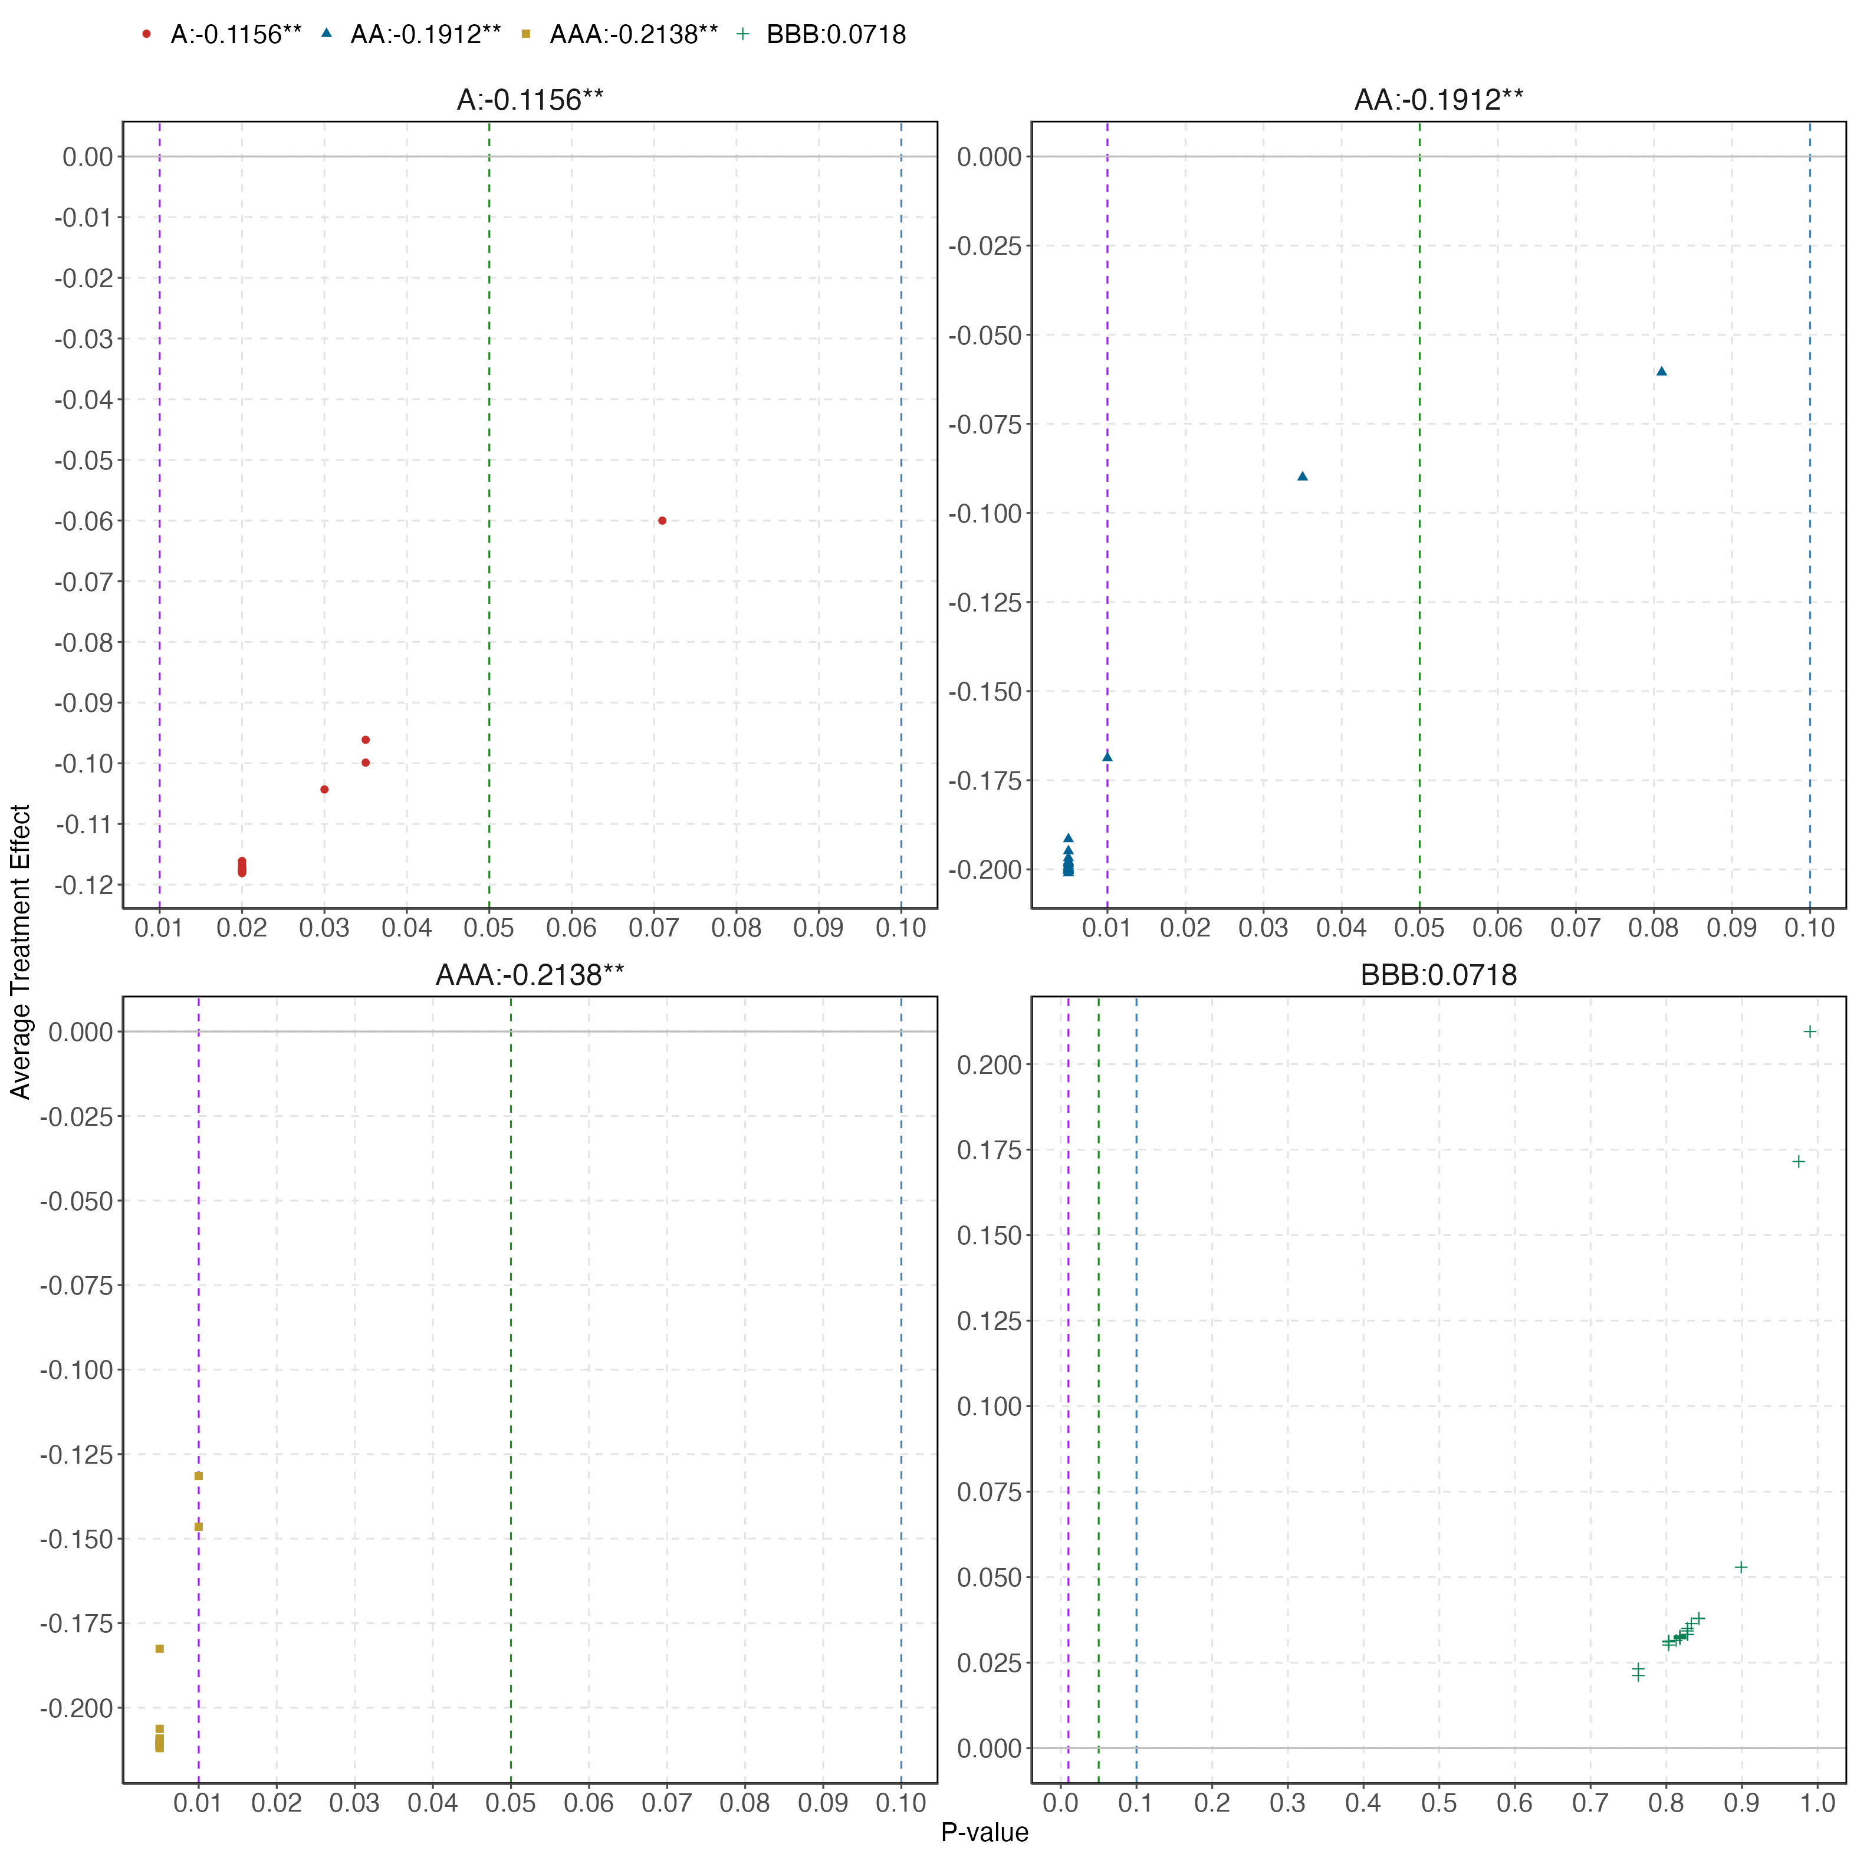
Leave One Out

Slide 8
Asset Classes: Only Muni Bonds

Slide 9
Asset Classes: Only Muni Bonds

Slide 10
Include currencies into the donor pool

Slide 11
Bug Address
Issue: donors were including treated units.
Only affected the estimation of AAA outcome. The algorithm was selecting AA as a donor and assigning 12% of weight.
Went undetected because donor weight plot does not shows weight without label.

Slide 12
Bug Address
After correction
AAA: Effect increases in magnitude, but loses precision (still statistical significant)

Slide 13
Bug Address

Slide 14
Bug Address

